Slide 1
How to best use these slides…
View the PPT as a slide show
Then click through every step
Mouse clicks will advance the slide show
Left/right arrow keys move forward/backward
Mouse wheel scrolling moves forward/backward
When a question is posed, stop and think it through, try to answer it yourself before clicking
If you have questions, use PS discussion boards, email me, and/or visit us in a Teams class session!

Slide 2
AP 2018 WordPairList FRQ Problem

Slide 3
The problem:
Below is a link to the FRQ problems from 2018.
Please take time to read through pages 7-11 for the WordPairList problem.
Page 7: class outline for both the supporting class WordPair and problem class WordPairList
Page 8-9: problem part A instructions and examples
Pages 10-11: problem part B instructions and example
Make sure you come back when you are done!
We will next walk through the problem including solving it.
2018 FRQ Problems

Slide 4
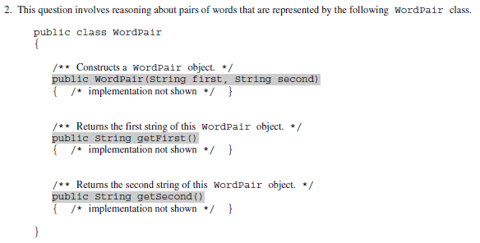
Page 7: the supporting class WordPair
Carefully read the description
This class encapsulates the data our main class will use…an individual word pair
The ArrayList in the code we will write will hold instances of this class
Note that we don’t get to (or need to) see the code for each method
We just need to know what methods are available to us
We are provided:
The constructor
getFirst(): a method to give us a copy of the first word for this pair
getSecond(): a method to give us a copy of the second word for this pair
WE DO NOT NEED TO WRITE CODE FOR THIS CLASS … IT IS A HELPER CLASS
and look over the code

Slide 5
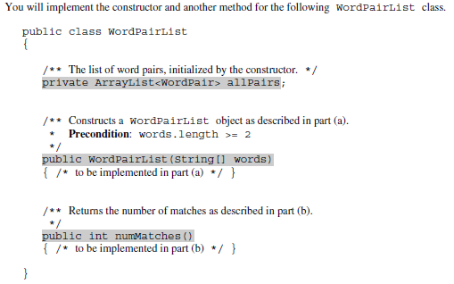
Page 7: the main problem class WordPairList
Carefully read the description
We will write the constructor and the numMatches() method for this class:
Part A is the constructor
Part B is numMatches()
Here is the ArrayList<> we will be working with:
The comment is clear: we need to initialize the list (use “new”) in the constructor we write.
and look over the code

Slide 6
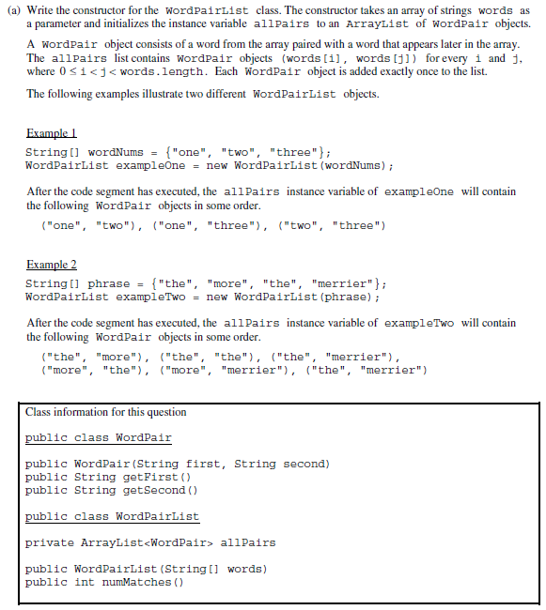
Page 8-9: part A the constructor
I will leave it up to you to read the:
Problem description
Example(s)
Essential class info
How will this work?
Given an array of strings named words
…fill the ArrayList with WordPair objects
This sentence tells it all!
Every WordPair is a word from the input array paired with a word that comes after it in the input array.
We need to run through the input array one word at a time, and pair it (one at a time) with each word that comes after it.
This means we will need a nested loop!
Also note it says “Each WordPair object is added exactly once to the list.”
Means no duplicate objects
Which means no duplicate references
It is okay to have duplicate content, i.e. two different WordPair object with same words in them.
Carefully study the examples
Example 1
…looking at this using color…
Input: 1, 2, 3
Output: (1, 2), (1, 3), (2, 3)
Example 2
Input: 1, 2, 1, 3
Output: (1, 2), (1, 1), (1, 3), (2, 1), (2, 3), (1, 3)
Make sure before you move on that you understand how the pairs are made!
Compare the text/String example to the right with the color examples above.
The Plan
Must initialize the ArrayList in the constructor
Loop through the input array one word at a time
This word will be the first in the next set of pairs
Loop through the input array STARTING AT THE NEXT WORD AFTER THE CURRENT ONE
Make a new pair using the word from the outer loop and the word from the inner loop
Add this new pair to the ArrayList

Slide 7
The code for part A!
public WordPairList(String[] words) {
allPairs = new ArrayList<WordPair>();
for ( int i = 0 ; i < words.length ; i++ ) {
for ( int j = i+1 ; j < words.length ; j++ )
allPairs.add( new WordPair(words[i], words[j]) );
}
}
}
int j = i+1
The Plan
Must initialize the ArrayList in the constructor
Loop through the input array one word at a time
This word will be the first in the next set of pairs
Loop through the input array
STARTING AT THE NEXT
WORD AFTER THE
CURRENT ONE
Make a new pair using the word from the outer loop and the word from the inner loop
Add this new pair to the ArrayList
outer loop
inner loop

Slide 8
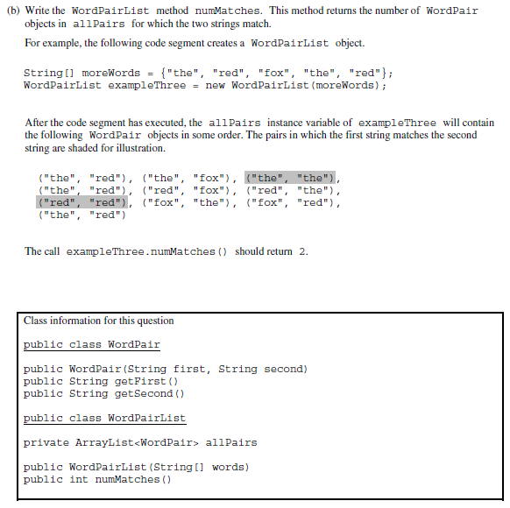
Page 10-11: part B numMatches()
I will leave it up to you to read the:
Problem description
Example(s)
Essential class info
How will this work?
Count all the WordPairs in our ArrayList for which the 1st & 2nd words match.
Note they are saying “match” not “equal”
This is a subtle reminder that…
…we CANNOT use == with String
MUST use .equals()
We will use the getFirst() and getSecond() from the supporting class WordPair
This is pretty straight forward…
The Plan
Init our counter to zero
Loop through the ArrayList
if this WordPair’s 1st word .equals the 2nd
count++
When done with the loop, return the count

Slide 9
The code for part B!
The Plan
Init our counter to zero
Loop through the ArrayList
if this WordPair’s 1st word .equals the 2nd
count++
When done with the loop, return the count
public int numMatches() {
int count = 0;
for ( int i = 0 ; i < allPairs.size() ; i++ ) {
if ( allPairs.get(i).getFirst().equals( allPairs.get(i).getSecond() ) ) {
count++;
}
}
return count;
}

Slide 10
Homework Assignment
See the class website assignment page!
Got a bunch of problems on Codingbat.org to do.
Have fun!

